Slide 1
Somatic mutations in Cancer and COSMIC database
Feb 16 2025
Giảng viên: TS. Lưu Phúc Lợi
Luu.p.loi@googlemail.com

Slide 2
Lecture Content
Somatic mutations in cancer
COSMIC database

Slide 3
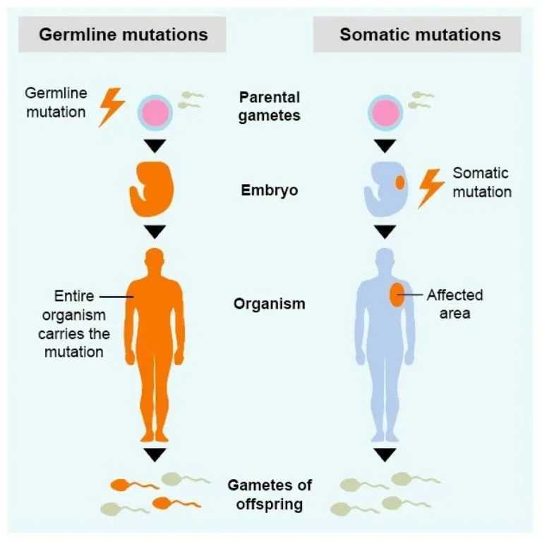
Somatic mutations in cancer
An alteration in DNA that occurs after conception.
Somatic mutations can occur in any of the cells of the body except the germ cells (sperm and egg) and therefore are not passed on to children.
These alterations can (but do not always) cause cancer or other diseases (somatic variant).
https://learn.colontown.org/topic/cancer-and-my-genes/

Slide 4
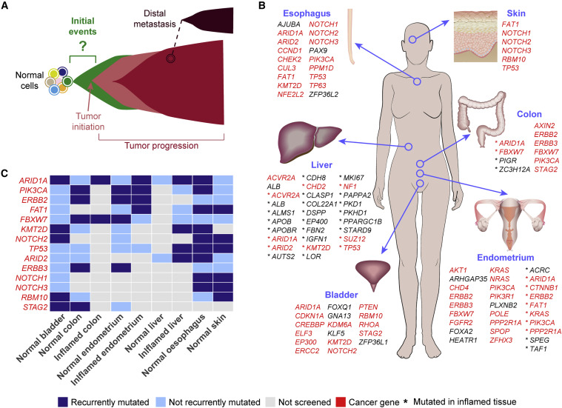
Genetic diseases of somatic cells, example: cancer
Landscape of Somatic Mutations in Human Adult Tissues
Schematics of cancer initiation and progression. The initial driver events that lead to tumor formation starting from normal cells are currently mostly unknown.
Mutated genes under positive selection (Brunner et al., 2019; Lawson et al., 2020; Lee-Six et al., 2019; Martincorena et al., 2015, 2018; Moore et al., 2020; Olafsson et al., 2020; Yokoyama et al., 2019) or frequently mutated (Anglesio et al., 2017; Lac et al., 2019a, 2019b; Lee-Six et al., 2019; Suda et al., 2018; Yokoyama et al., 2019; Zhu et al., 2019) in the human adult tissues that have been screened so far.
List of genes under positive selection or frequently mutated in at least two tissues. Cancer genes were derived from the Network of Cancer Genes (http://ncg.kcl.ac.uk/) (Repana et al., 2019).
https://doi.org/10.1016/j.ccell.2020.11.002

Slide 5
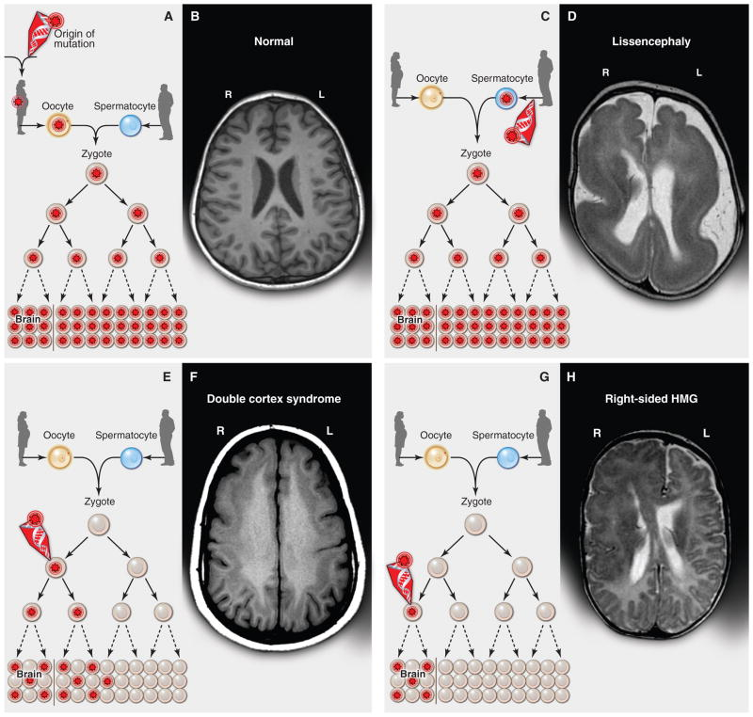
Genetic diseases of somatic cells, example: epilepsy
(A) A heterozygous mutation is inherited from one parent. This mechanism is typical of autosomal dominant epilepsy. In this example, the mutation originally presented in the mother, whose oocytes in turn carry the mutation. (The mutation arose during gametogenesis in one of the parents of the mother, top left.) It is present in the zygote and thus all cells of the affected child. (B) This axial T1-weighted image from a MRI study of a patient with inherited epilepsy appears normal. Individuals with dominantly inherited epilepsies caused by mutations in genes encoding ion channels, for example, have normal neuroimaging studies despite every cell carrying a mutation. (C) A de novo mutation may arise sporadically during gametogenesis, in this case spermatogenesis. This mechanism of mutation would be typical of a de novo mutation in the gene SCN1A associated with severe myoclonic epilepsy of infancy or LIS1 associated with lissencephaly. Even though every cell in the individual carries the mutation, the predominant effects of the mutation depend on the distribution of gene expression; in these examples, the brain is primarily affected. (D) An axial T2-weighted MRI image shows the severe gyral simplification—more pronounced posteriorly (the bottom of the figure)—that is associated with mutations in the gene LIS1. (E) An early post-zygotic mutation results in a mutation present in most or all tissues of the organism (including the leukocytes, which are generally assayed for clinical genetic testing) but in a mosaic fashion, with only a portion of all cells in each tissue harboring the mutation. This pattern, illustrated by the axial T1-weighted image in (F), has been observed in mosaic cases of double cortex syndrome involving the gene DCX. Visible is the extra band of gray matter underlying the normal-appearing outer aspect of the cerebral cortex. Because DCX is required for normal migration of neurons from the ventricular region deep in the brain to the superficial cortex, the cells carrying the DCX mutation only migrate about halfway to the cortex and then arrest their migration. (G) A late post-zygotic mutation will be present in only certain tissues in a mosaic fashion, in this case apparently in half of the brain. This is the pattern observed in some cases of HMG with somatic mosaic point mutations in AKT3 and other related genes and somatic mosaic increase of copy number of chromosome 1q. (H) This axial T2-weighted MRI image shows right-sided HMG, characterized here by enlargement of the right hemisphere, abnormally thick and dark-appearing gray matter anteriorly, heterotopic periventricular gray matter, and abnormal white matter signal in the right hemisphere. (R, right; L, left).
https://pmc.ncbi.nlm.nih.gov/articles/PMC3909954/

Slide 6
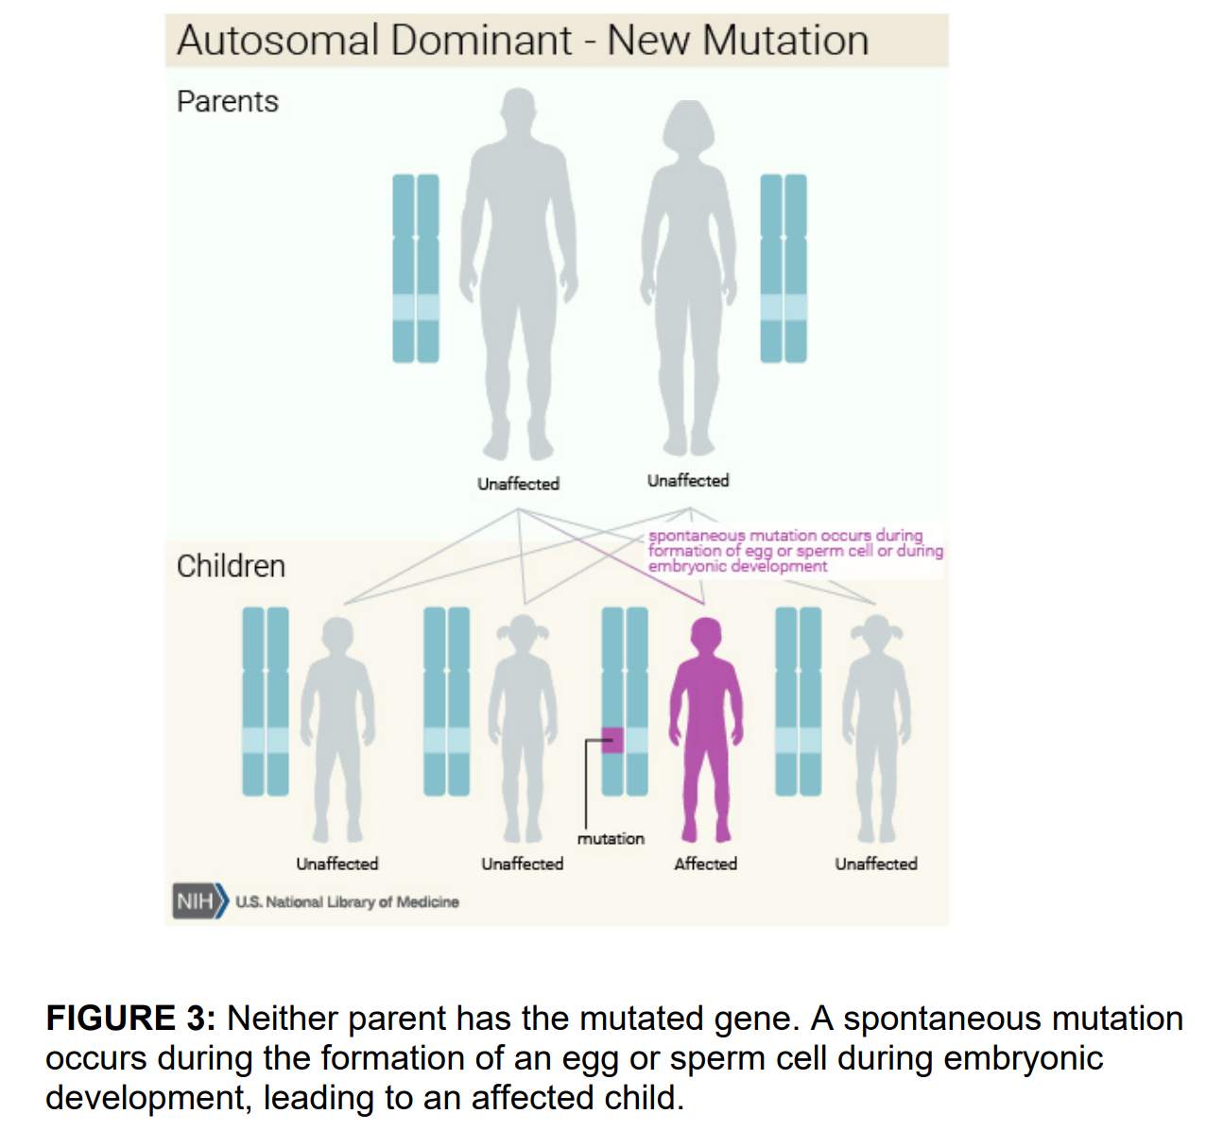

Slide 7
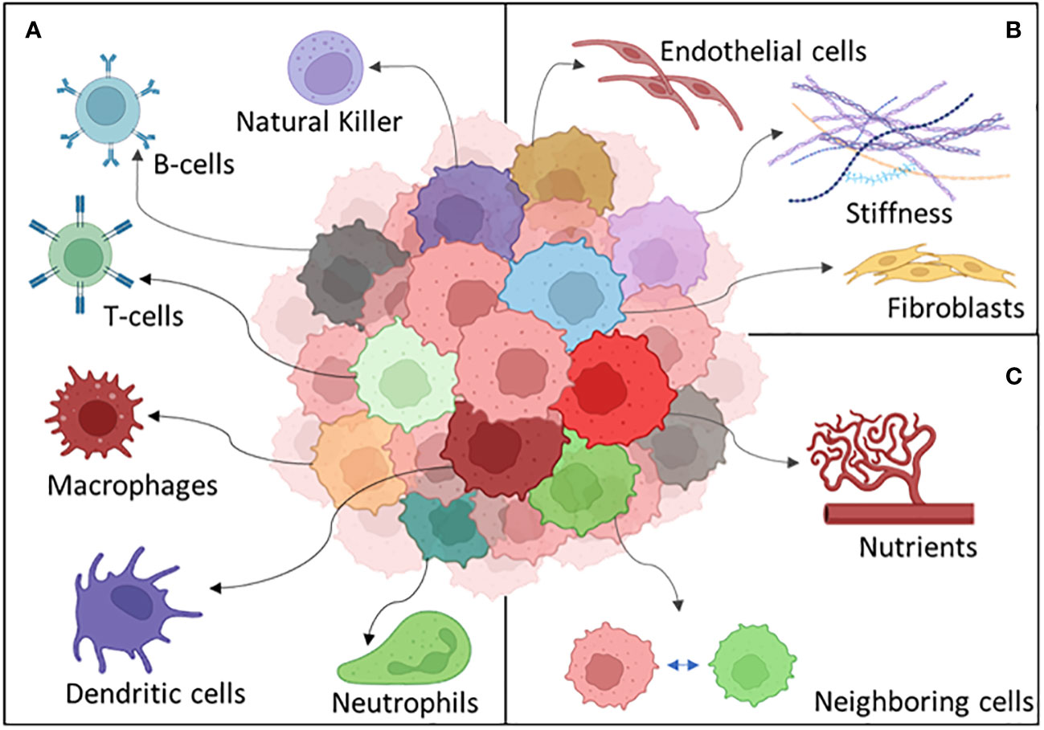
Tumor heterogeneity

Slide 8
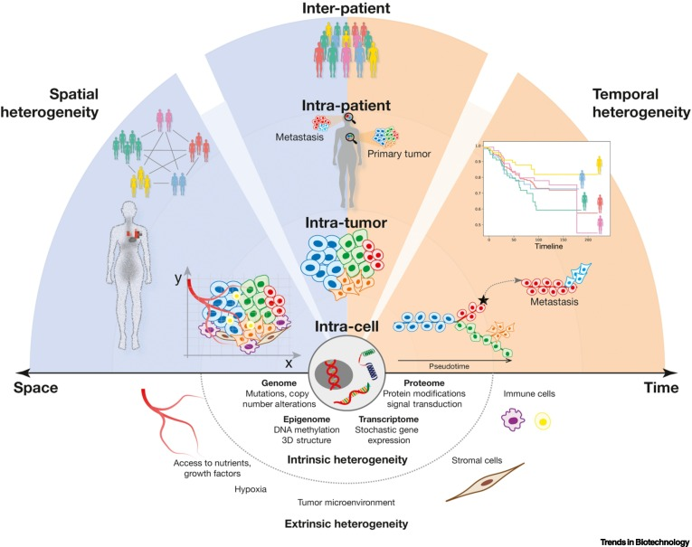
Tumor heterogeneity
10.1016/j.tibtech.2021.11.006

Slide 9
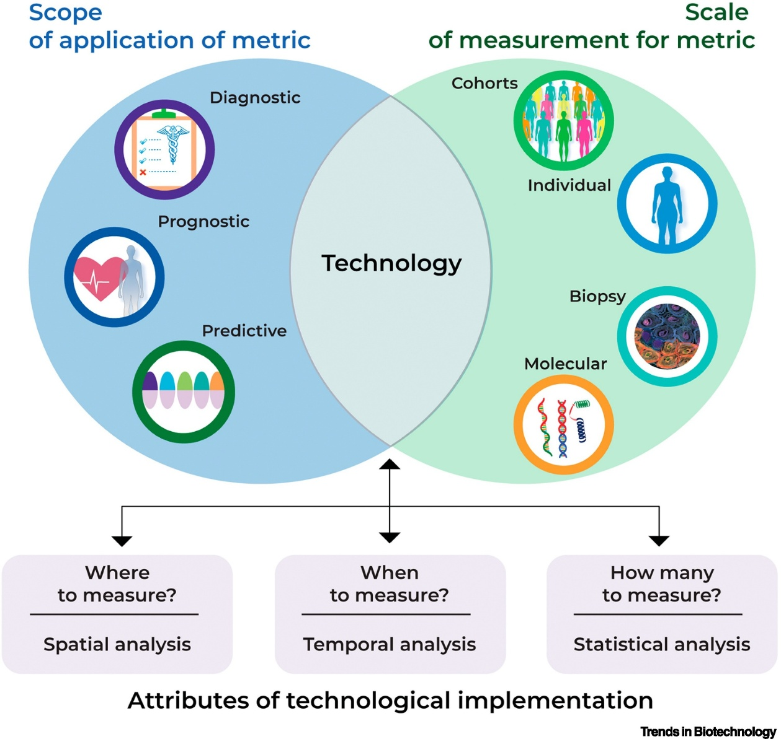
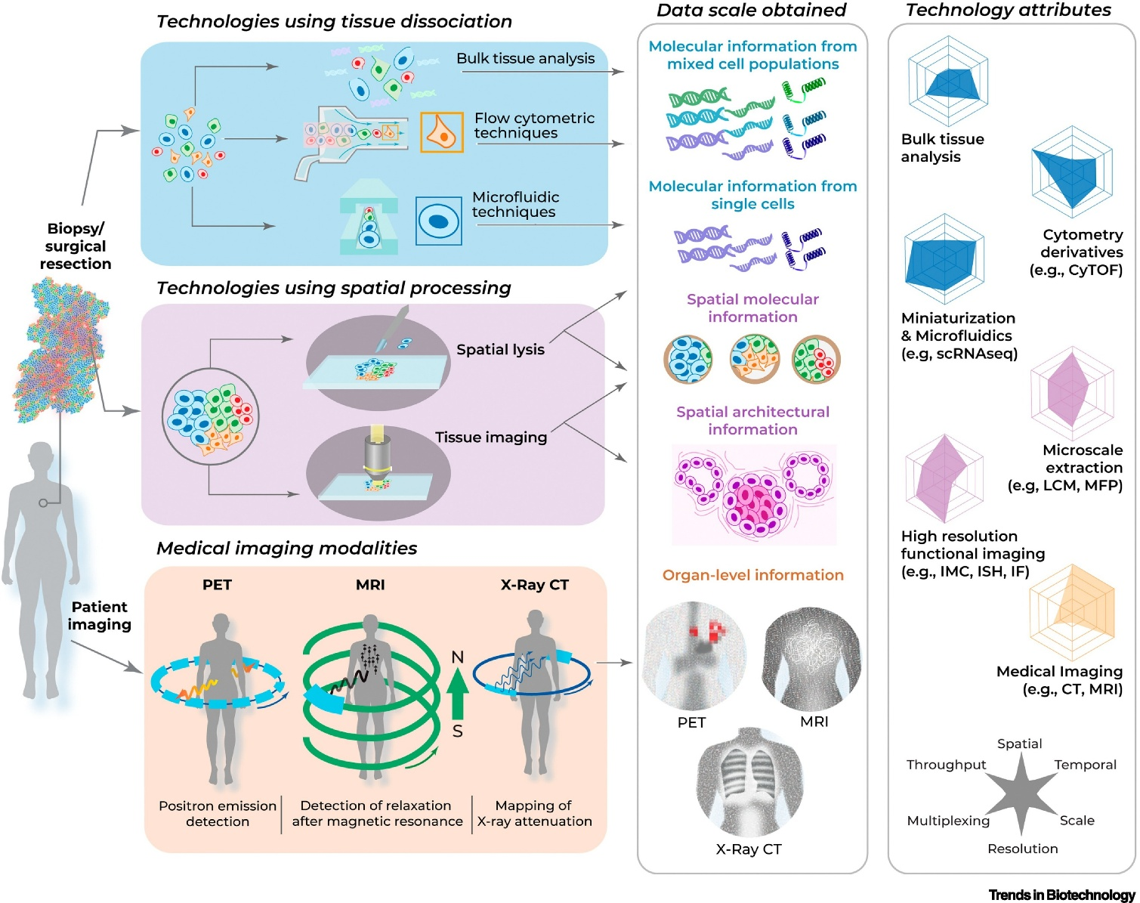
Scope and how to profile tumor heterogeneity
10.1016/j.tibtech.2021.11.006

Slide 10
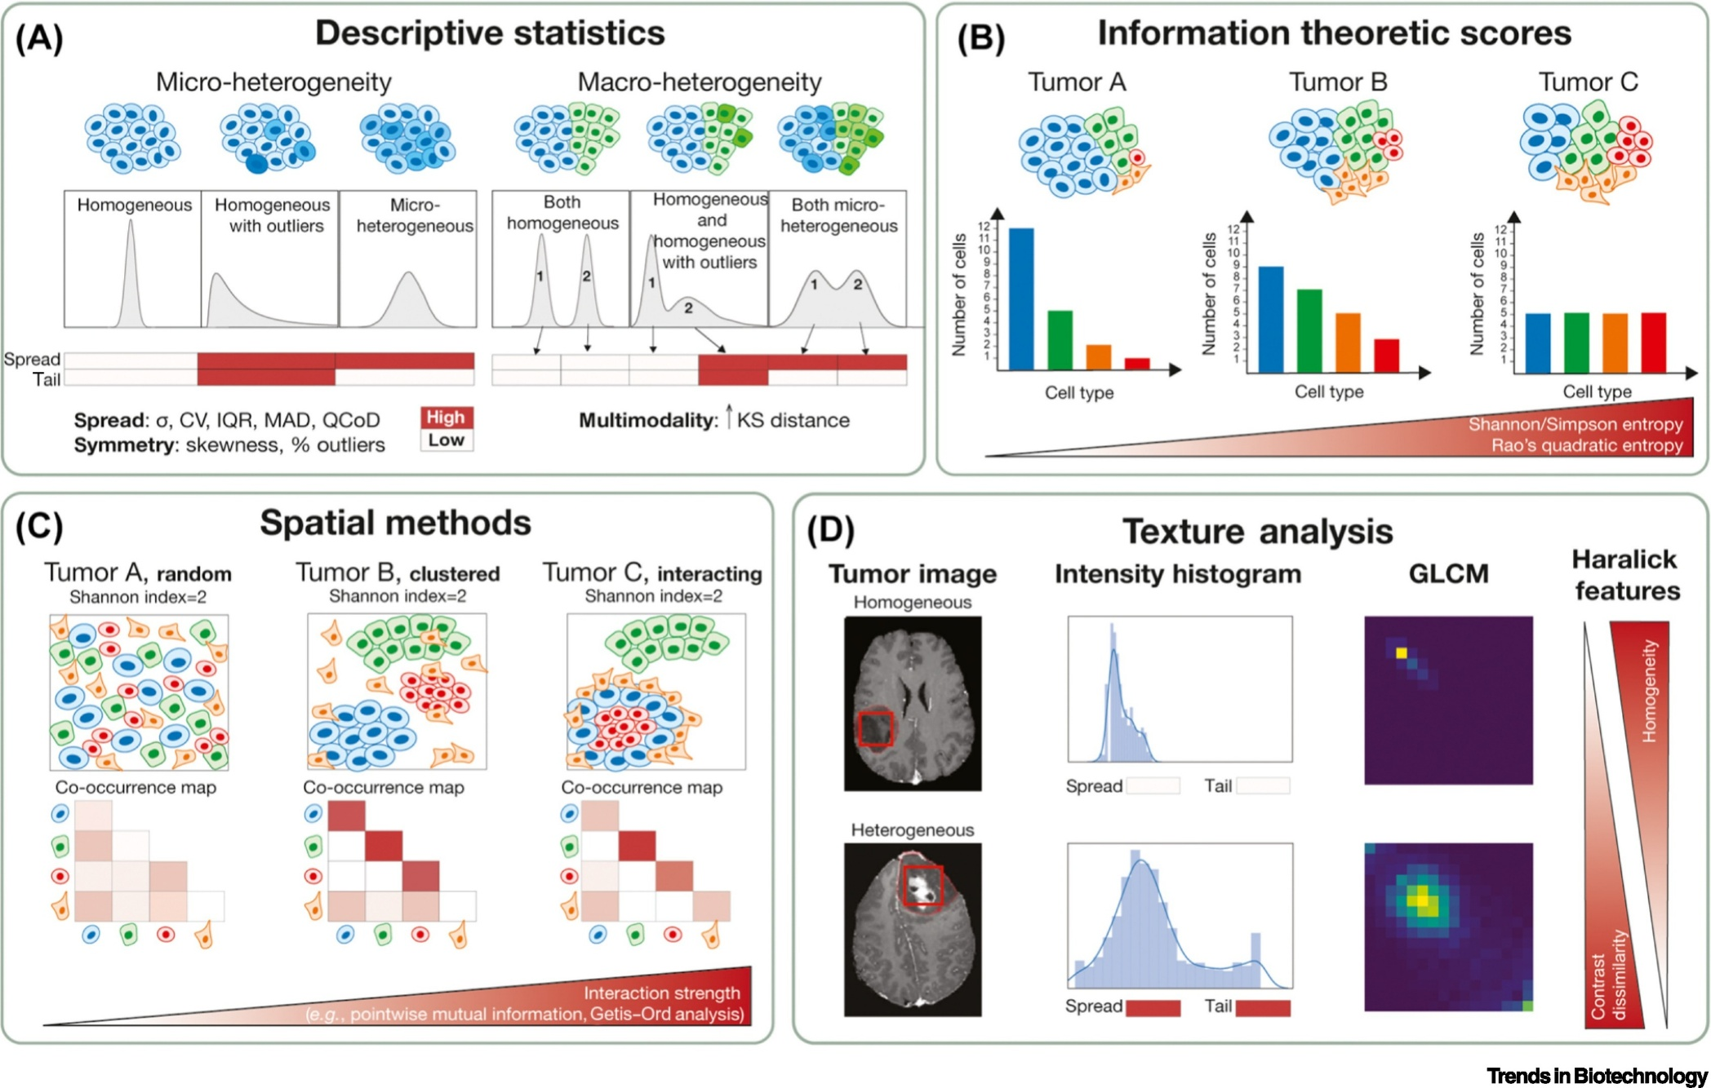
Quantification of tumor heterogeneity using different computational approaches
10.1016/j.tibtech.2021.11.006

Slide 11
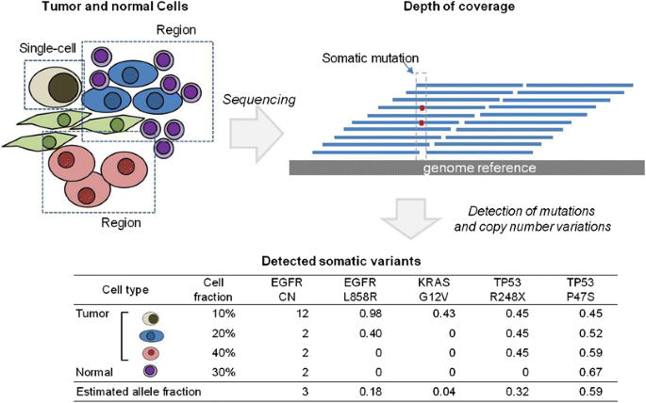
Sequencing Tumor and somatic mutations
https://link.springer.com/article/10.1007/s00439-016-1670-x

Slide 12
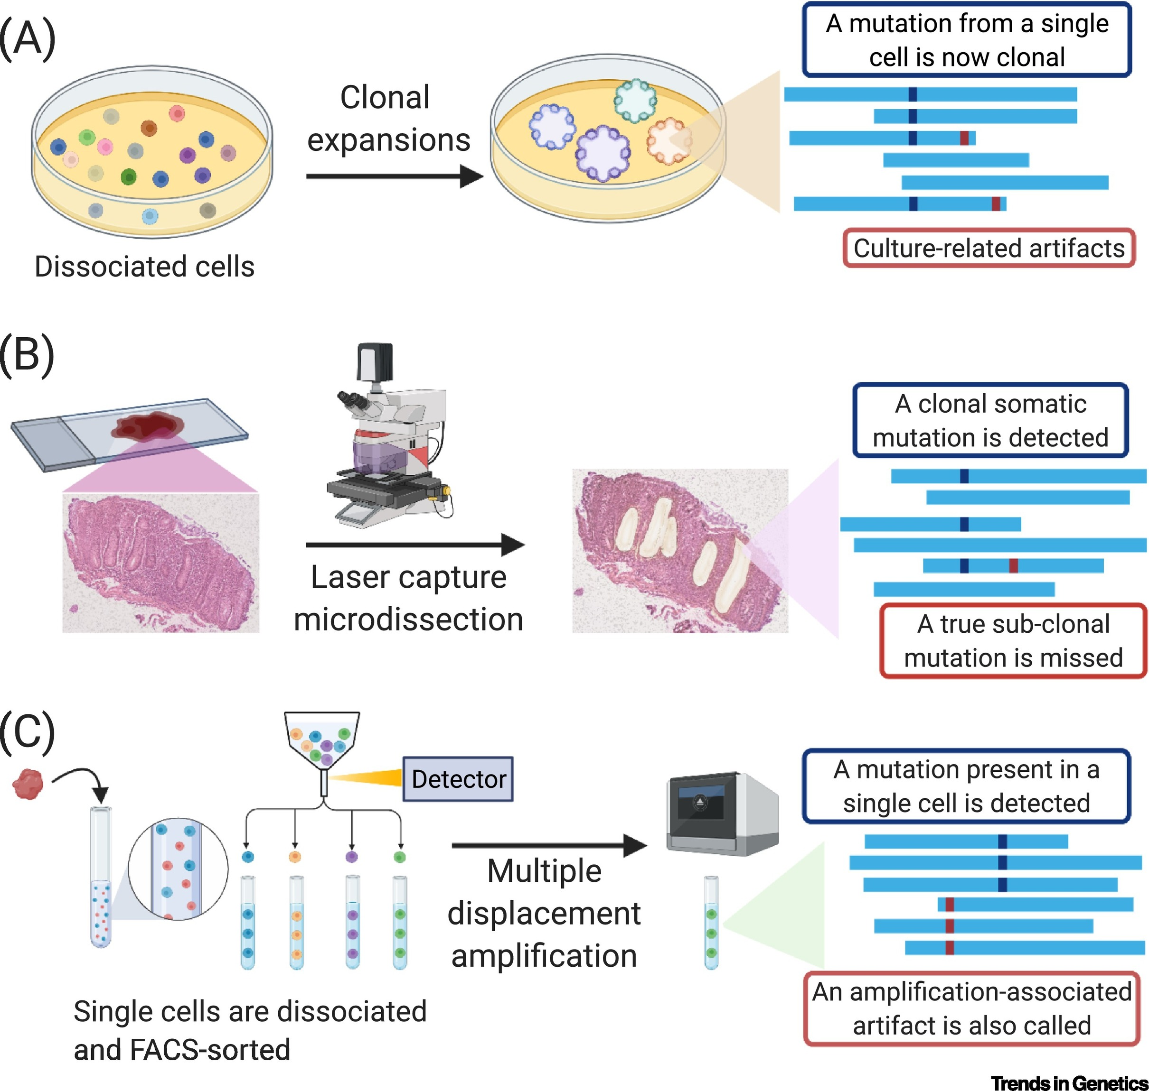
Methods for the study of somatic mutations
(A) Expansion of single cells in culture followed by sequencing.
(B) Laser capture microdissection of tissue sections can isolate clonal or semiclonal populations of cells that can be sequenced.
(C) Single-cell DNA sequencing after dissociation and sorting. Abbreviation: FACS, fluorescence-activated cell sorting. Figure created with BioRender.com.
https://www.cell.com/trends/genetics/fulltext/S0168-9525%2821%2900168-2

Slide 13
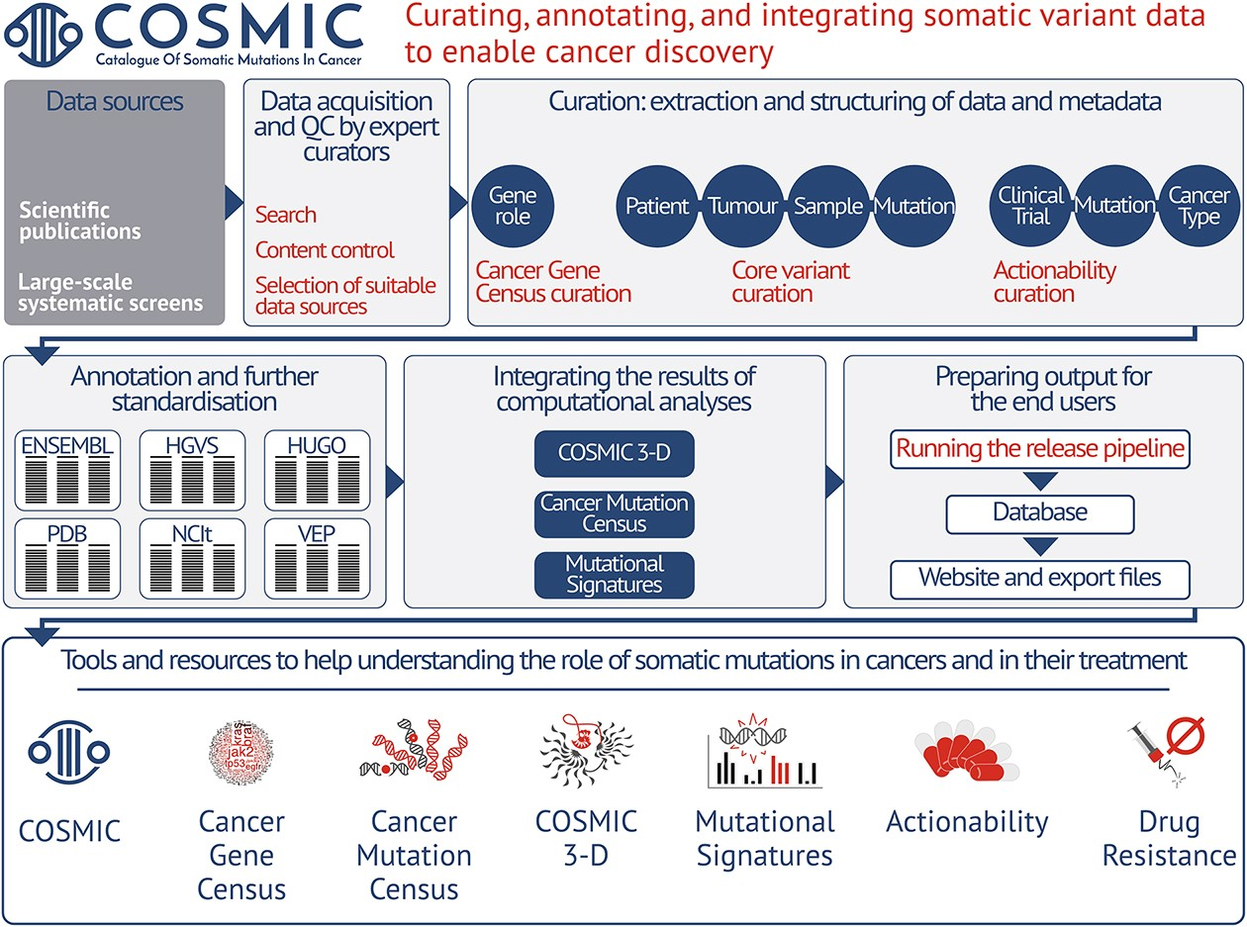
COSMIC: a curated database of somatic variants and clinical data for cancer
https://academic.oup.com/nar/article/52/D1/D1210/7335750

Slide 14
Xin chân thành cảm ơn!
Luu Phuc Loi, PhD
Zalo: 0901802182
luu.p.loi@googlemail.com

